Slide 2
Process and Systems of Trauma
Support the management of trauma in the emergency and urgent care setting - Component 8

Slide 3
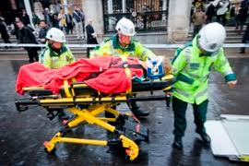
Objectives
Explain the process and the systems in place to effectively manage a trauma patient.

Slide 4
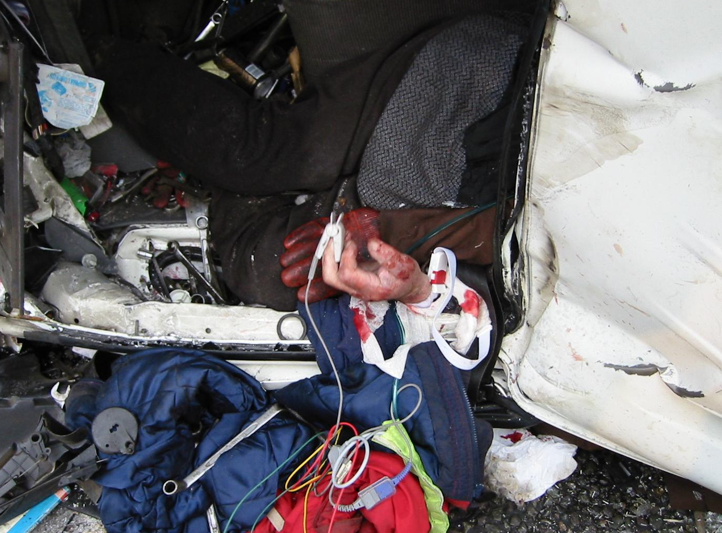
What Is Trauma?
Trauma is when an injury occurs due to an external source of energy transferring to the body faster than the body can sustain and dissipate it.
Notes:
Ref: Ambulance Care Essentials, 2nd edition. Chapter 16 Trauma pg 247.
https://www.nao.org.uk/wp-content/uploads/2010/02/0910213.pdf – national audit office 2010
The body can only withstand a certain amount of physical, environmental and physiological stress, when the force exceeds this limit an injury occurs. The force required to cause an injury is dependent upon the structure/type of tissue which has been affected, the age of the patient, along with the magnitude and duration of the energy that is being transferred.
An injury is the acute physiological and structural change that occurs to the patients body.

Slide 5
What Is Major Trauma?
When an injury is likely to result in permanent disability or death.
Notes:
Ref: Ambulance Care Essentials, 2nd edition. Chapter 16 Trauma pg 247.
https://www.nao.org.uk/wp-content/uploads/2010/02/0910213.pdf – national audit office 2010
The body can only withstand a certain amount of physical, environmental and physiological stress, when the force exceeds this limit an injury occurs. The force required to cause an injury is dependent upon the structure/type of tissue which has been affected, the age of the patient, along with the magnitude and duration of the energy that is being transferred.
An injury is the acute physiological and structural change that occurs to the patients body.

Slide 6
Facts
Major trauma is the leading cause of death in patients <40.
Each trauma death costs the nation in excess of £0.75 million.
The cost of immediate treatment of major trauma is between £0.3-0.4 billion per year.
22 MTC’s were introduced across England from April 2012 – Four of these are in London.
Since the introduction of major trauma centre’s the chance of surviving has increased by 20%.
Notes:
Ref: https://www.nice.org.uk/news/press-and-media/nice-publishes-five-new-guidelines-to-standardise-trauma-care-in-england (2016)
https://www.gov.uk/government/news/new-major-trauma-centres-to-save-up-to-600-lives-every-year - 22 MTC’s introduced
https://www.nao.org.uk/wp-content/uploads/2010/02/0910213.pdf – national audit office 2010. (Below)
In England: Estimated 20,000 cases of major trauma per year (of which RTC’s are the most common)
Resulting in approximately 5400 deaths and many more with permanent disabilities per year
A further 28,000 per year are not defined as major trauma but treated in the same way

Slide 7
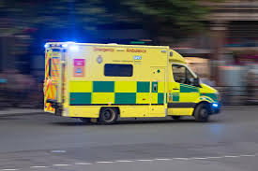
Trauma in London
Data gathered between April 2018-June 2019
Average of 20 trauma patients per day
Average journey to a major trauma centre (MTC) was 18 minutes.
Average time on scene:
  Blunt injuries – 37 minutes (Aim for <20 minutes)
  Penetrating injuries – 15 minutes (Don’t delay on scene for any action which isn’t absolutely necessary)

Slide 8
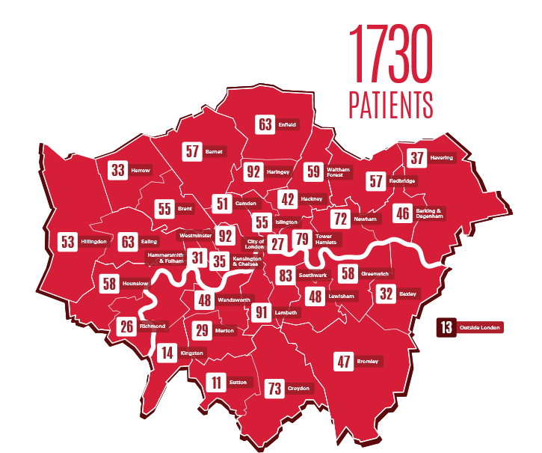
HEMS
Mechanism of injury in relation to patient’s HEMS attended:
28% RTCs
22% Falls from height
32% Penetrating trauma
14% Other
Notes:
Ref: https://londonsairambulance.co.uk/our-service/our-work/mission-maps/2019
Figures and map update for 2019

Slide 9
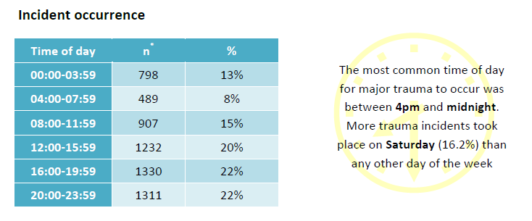
Prevalence of trauma in London
Notes:
London Ambulance Service Major Trauma Report 2016-2017 (latest available) https://www.londonambulance.nhs.uk/about-us/our-publications/
Time of day when major trauma incidents occur. The quietest time of day appears to be between 4 and 8am, with the busiest time of day between 16.00-00.00.

Slide 10
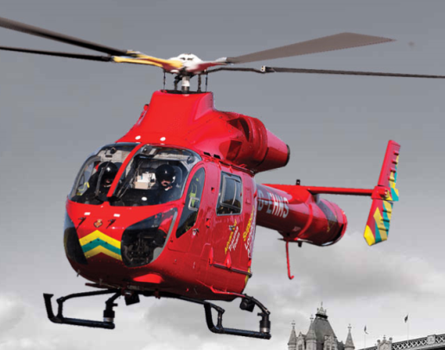
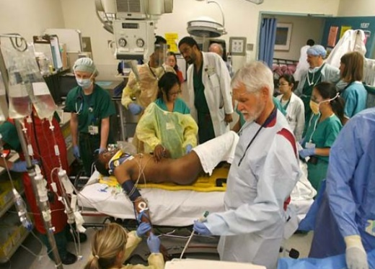
Multi-disciplinary services available
Advanced Paramedics (APP)
HEMS (Helicopter or response car)
  Doctor
  Paramedic
  Pilot (Helicopter)
Major Trauma Centre
  Specialist consultants (consultant led care)
  Specialist nurses
  Specialist doctors
  Surgeons
  Many specialist areas for rehabilitation after initial treatment
Notes:
Provide: Advanced clinical assessment, use of stronger analgesia, sedatives, surgical airways, ventilators and other advanced skills and interventions,. APP’s carry the Lucus device
Dispatched alongside HEMS in trauma
http://www.nhs.uk/Services/hospitals/Services/Service/DefaultView.aspx?id=103289
St Mary’s multidisciplinary team which includes physiotherapists, occupational therapists, speech and language therapists and dieticians with a wide variety of specialist skills including, neurosciences, paediatrics, orthopaedics, amputee prosthetic limb management, hand therapy and acute respiratory management.

Slide 11

Value of multi-disciplinary services
22 MTC’s were introduced across England from April 2012 – four of these in London
Since the introduction of MTC’s the chance of surviving a major trauma event has increased by 20%, resulting in 1,600 lives saved from 2012-early 2018.

Slide 12
HEMS Dispatch Protocol
IMMEDIATE DISPATCH – 3 minutes to dispatch
Person under train
Fall >2 floors (>20feet)
Ejected from vehicle
Trapped under vehicle (not motorcycle)
Death of same vehicle occupant
Traumatic Amputations above wrist or above ankle
Other emergency service request (including RNLI)
Notes:
Information gained from HEMS Paramedic (2/3/2016 by email)

Slide 13
INTERROGATION DISPATCH – 7 minutes to dispatch
INTERROGATION DISPATCH – 7 minutes to dispatch
Fall from height < 2 floors
RTCs
Entrapments
Impaled on an object
Amputations
Stabbing / Shooting
Burns / Scalds
Electrocution
Industrial accidents
Building site accidents
Explosions
Hangings
Drowning
Interrogation can be completed passively by calling back the origin for more information, or silently by listening in to the 999 call.
Notes:
Information gained from HEMS Paramedic (2/3/2016 by email)
These lists are not exhaustive as HEMS will adapt to decide what they believe they will be needed on.

Slide 14
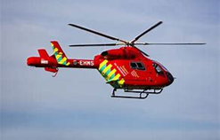
The major trauma system
  Trauma Tree used to ensure patients are appropriately transported to a MTC
  Local hospital for stabilisation if required (unmanageable airway problem)
  Pre-hospital care is crucial – HEMS and ambulance staff work closely together to provide initial care and ensure patients are in the most appropriate place.
Notes:
The major trauma system starts with the 999 call, which if particular details are given will result in an ambulance being dispatched, alongside HEMS and APP’s as required. If HEMS are unsure if required then the LAS crew will be asked to report to HEMS on arrival at scene.
As the initial contact with the patient the LAS crew plays a vital part in getting the patient to hospital and stabilising where possible.

Slide 15
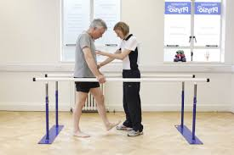
Rehabilitation
Major Trauma Centre (MTC)
  A focussed assessment is conducted by a specialist trauma team
  The trauma team will then perform the necessary life saving interventions
Rehabilitation
  After severe injury reconstructive surgery is often required
  Personalised rehabilitation programme to help return to an active life from professionals such as:
    Physiotherapists
    Occupational therapists
    Speech and language therapists

Slide 16
To establish good trauma care…
Seriousness of the injury identified on scene/as early as possible.
Transferred to MTC as soon as major trauma recognised.
CT scans etc. completed immediately on arrival at hospital
Appropriate rehabilitation programmed started.
Good trauma care involves getting to the right place at the right time for the right care.

Slide 17
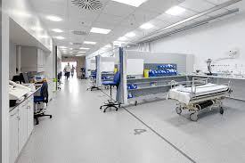
The role of MTC’s
Open 24/7.
Consultant led care.
Access to the best diagnostic and
treatment facilities.
Access to vital rehabilitation after
initial treatment.

Slide 18
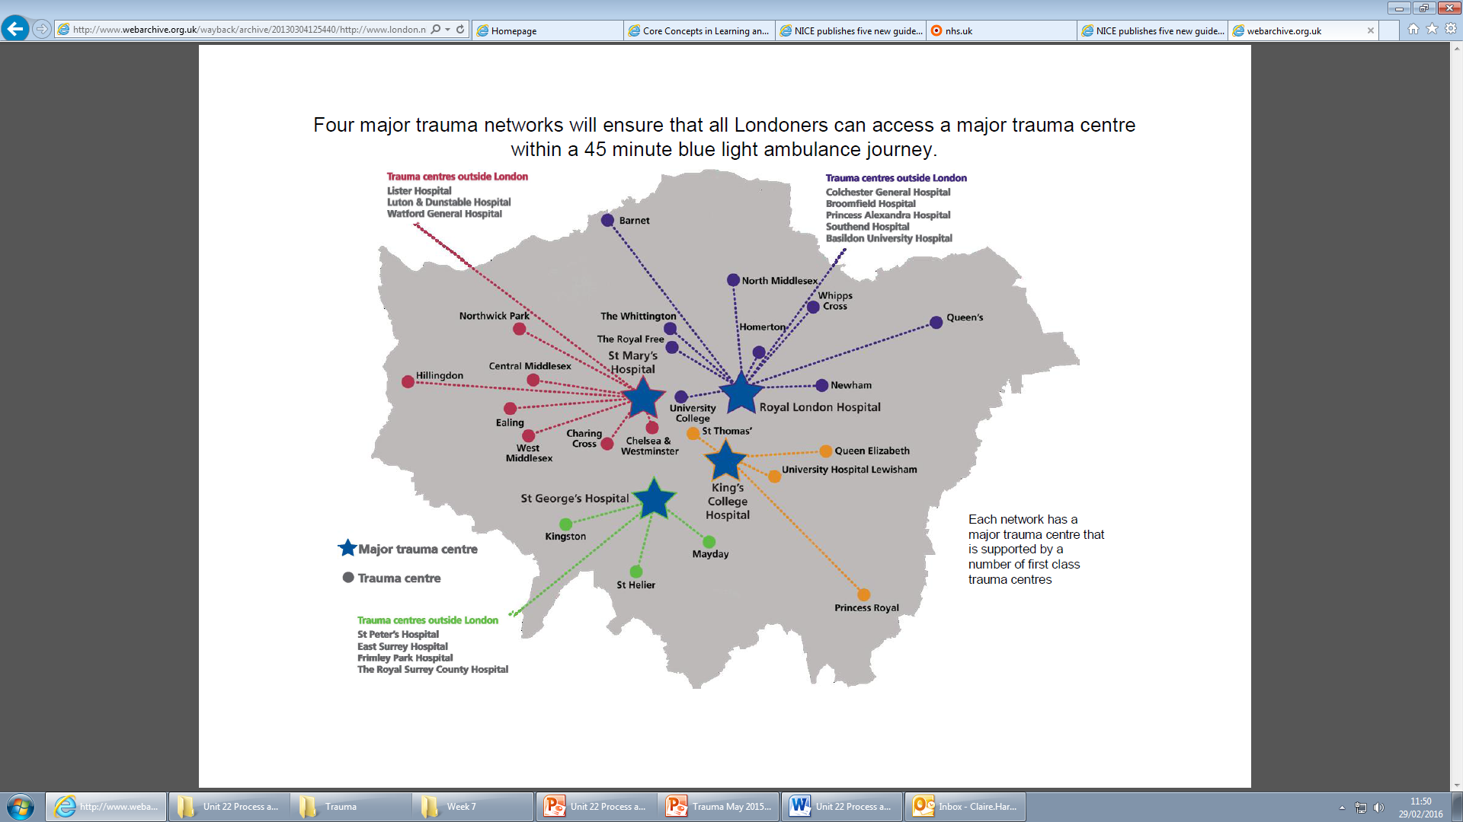
Notes:
The trauma network above was agreed in 2009 after a publication came out regarding improving the care of major trauma patients (The Pulse)
Average journey to MTC is 18 minutes.

Slide 19
Major trauma decision tree
Designed to identify and triage patients who may benefit from a specialist trauma centre
Two versions (adult and child)
Always check the trauma tree before conveying to trauma centre – inappropriate use will block beds and delay ambulance availability
When using the trauma tree, the step triggered must be documented on the PRF
Notes:
London Ambulance Service- Major Trauma Annual report 206-2017.

Slide 20
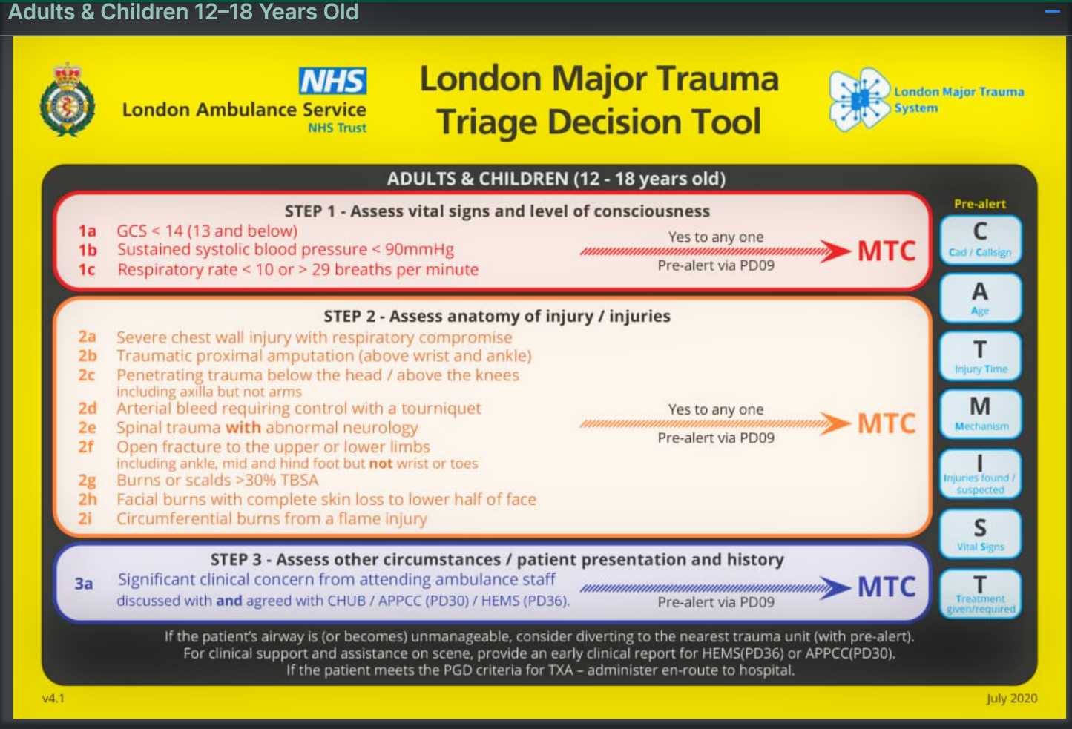
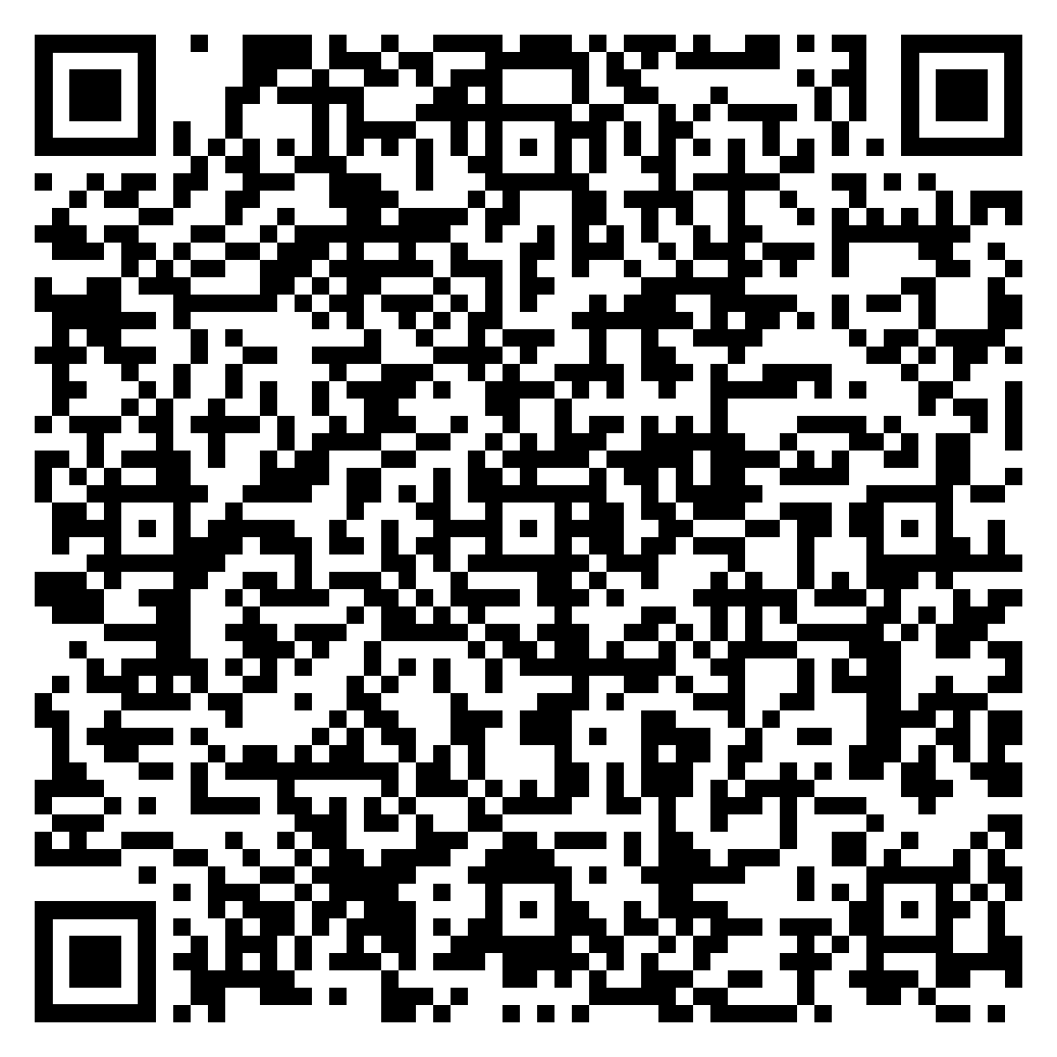
Major Trauma Decision Tool
The Trauma tree can be accessed via this link: Trauma Tree
Or by using the QR code.
Notes:
Joint royal Collages Ambulance Liaison Service JRCALC (plus) accessed 5th October 2020.
Learners can access the trauma tree on their iPads via JRCALC PLUS

Slide 21
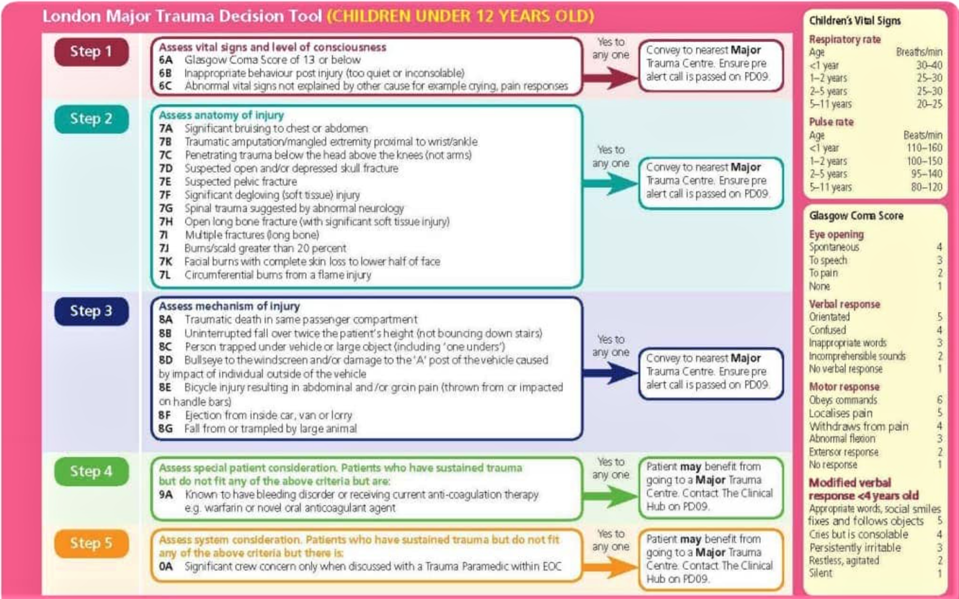
Major Trauma Decision Tool – under 12 years
Notes:
Joint royal Collages Ambulance Liaison Service JRCAL (plus) accessed 6th May 2020.
Learners can access the trauma tree on their ipads via the DPG app

Slide 22
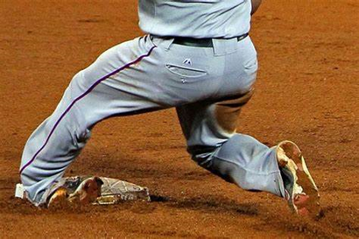
What does Mechanism Of Injury (MOI) mean?
Mechanism Of Injury
The MOI is the sum of all physical forces that is exerted on the body which results in an injury.
Notes:
Ref: Ambulance Care Essentials 2nd edition – Chapter 16 Trauma pg 250.

Slide 23
Establish the MOI
You will need to establish the MOI for any patient who has been injured. This alone cannot predict or exclude an injury, but will aid your history and assessment of the patient.
To establish this you will need to gather information regarding the events leading up to the incident. This may not always be consistent with your findings - highlighting the importance of a good primary/secondary survey.
Notes:
Ref: Ambulance Care Essentials 2nd edition – Chapter 16 Trauma pg 250.

Slide 24
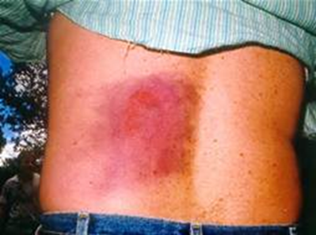
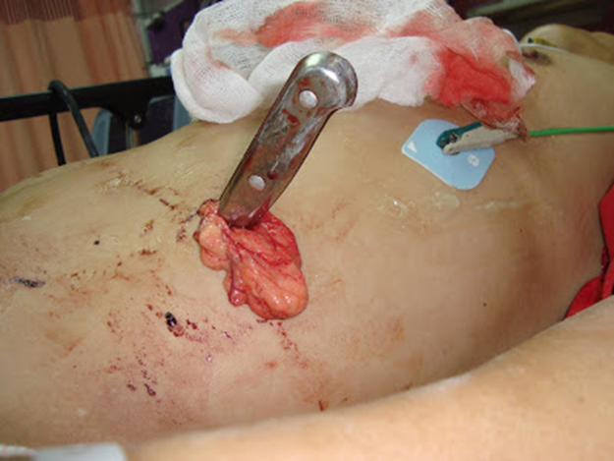
Types of MOI
Fall from standing/sitting/height
Abnormal flexion/extension/rotation of joints
(i.e. whiplash or c-spine injuries in a RTC)
Blunt trauma (Deceleration and compression force)
Penetrating trauma
Entrapment
Notes:
Ref: Ambulance Care Essentials 2nd edition – Chapter 16 Trauma pg 250.

Slide 25
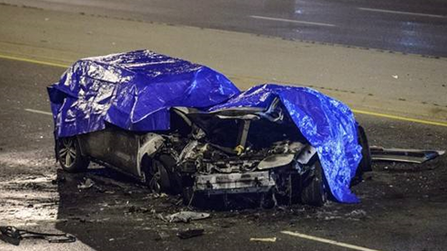
Significant mechanism
Fall >6m/2 storeys in an adult or fall >3m/2 times height of child
Entrapment (relative and absolute)
Motor vehicle:
Intrusion >30cm on occupants side
Ejection from vehicle
Death in same passenger compartment
Motorcycle crash >20mph
Pedestrian/cyclist vs. motor vehicle >20mph
When the above are present you must consult the LAS Major Trauma Tree
Notes:
Ref: Ambulance Care Essentials 2nd edition – Chapter 16 Trauma pg 250.
Relative entrapment describes when a patient is trapped by access/egress from the wreckage, including from a physical injury stopping their exit.
Absolute entrapment is when the patient is firmly trapped, requiring specialist cutting instruments to free the patient. Absolute entrapment means the patient is at high risk of having suffered a significant energy transference and at an increased risk of severe injury.

Slide 26
Special considerations
You should have a lower threshold for providing a trauma alert for:
A patient aged >55
Pregnant patients >20 weeks
Patient’s taking anti-coagulants (e.g. warfarin) or know to have bleeding or clotting disorders
Morbidly obese patients
Paediatrics <12
Your judgement
Notes:
London Ambulance service major trauma decision tool v3
Your judgement on a patient is included because, being a clinician on scene, if you believe the patient needs specialist trauma care then you can contact PD09 to discuss findings and find out if appropriate to convey to a MTC

Slide 27
Laws associated with trauma
The following laws of physics associated with trauma will assist you in understanding the MOI and help to define the types and patterns of injury that may occur:
Kinetic energy
Law of conservation of energy
Newton’s first law of motion
Newton’s second law of motion
Newton’s third law of motion
Law of thermodynamics
Notes:
Ref: Ambulance Care Essentials 2nd edition – Chapter 16 Trauma pg 249-250.

Slide 28
Kinetic energy
Kinetic energy = ½m X v²
In trauma think about the mass (m) of the object but more importantly the velocity (v) it travels at.
E.g. A car weighing 1500kg vs a static object:
½ 1500(kg) X 30²(mph) = 675,000KE units
½ 1500(kg) X 40²(mph) = 1,200,000KE units
Notes:
Ref: Ambulance Care Essentials 2nd edition – Chapter 16 Trauma pg 249
(½ 70 = 35, 30x30 =900) 35kgx900=31,500 KE
Kinetic energy – related to motion and the most common type of injury-causing energy. (other energies include: thermal, electrical, chemical, nuclear)
Velocity: distance an object travels per unit of time – this has the greater effect on kinetic energy as it is squared. The kinetic energy of an object involved in any type of collision must be dissipated as the object comes to rest
Examples on slide show difference in kinetic energy produced from just a 10mph speed change – important to take note of speeds and difference this can make on the impact to the patient. If the energy produced cannot be dissipated then it can result in an injury – modern cars have crumple zones to try to compensate for this excess energy.

Slide 29
Consideration
In an RTC some of this energy is dissipated through crumple zones before the passenger compartment shows evident damage.
Take into consideration:
The angle of impact (movement and impact of patient)
Difference in size of vehicles involved
Restraints used (i.e. seatbelts)
Safety mechanisms deployed (i.e. airbags)
Notes:
Caroline, N. 2008. Emergency Care in the Streets. Burlington: Jones and Bartlett Publishers. Pages: 939-949
Intrusion of the passenger compartment >30cm on occupants side is considered significant.
If the energy produced cannot be dissipated then it can result in an injury – modern cars have crumple zones to try to compensate for this excess energy.

Slide 30
Law of conservation of energy
“Energy can neither be created nor destroyed; it can only change form.”
E.g. RTC:
Brakes = thermal energy
Crash = mechanical energy
Protective devices = manipulate energy to dissipate further
Injury = mechanical energy
Notes:
Caroline, N. 2008. Emergency Care in the Streets. Burlington: Jones and Bartlett Publishers. Page:941
Seat belts = manipulate energy to body pressure force rather than deformation to torso from steering wheel.

Slide 31
Newton’s laws
Newton's First Law of Motion:
“A body at rest will remain at rest unless acted on by an outside force”
Newton's Second Law of Motions:
“The force that an object can exert is the product of its mass, times its acceleration”
(F = M X A)
E.g. In a head on collision of two cars travelling in the opposite direction it is important to take into account both speeds.
Notes:
Ref: Ambulance Care Practice 2nd edition Page: 313-314
Newton’s first law: A body in motion will remain in motion until a force acts on it. Most bodies stop through friction, wind and other forces causing deceleration.
Newton’s second law: Force = M X A (or deceleration).
Other considerations: Rear impact of two vehicles still travelling has a lesser deceleration due to the difference in speed between them. This is known as the closing speed.

Slide 32
Thermodynamics
Thermodynamics:
There are four laws of Thermodynamics
In relation to trauma it is important to understand heat transformation into thermal energy, the transfer of this energy is what will cause a burn injury.
Law | Description
First Law | The amount of energy added to a system is equal to the sum of its increase in heat energy and work done
Second Law | Heat energy cannot be transferred from a low temperature to a high temperature without the addition of energy
Third Law | In relation to a pure crystal at 0 degrees Kelvin: there cannot be a physical system with lower entropy (unavailability of heat for work). All entropy therefore has a positive value
Zeroth Law | If two bodies are in thermal equilibrium with a third body, they are in equilibrium with each other. (most fundamental law)
Notes:
Ref: http://www.thefreedictionary.com/thermodynamics
First Law = an example of the principle of conservation of energy
Second Law = Warm air outside can transfer into a cold room, cold air inside cannot transfer to the warm air outside without extra energy (e.g. air conditioner)
Third Law – The entropy of a pure crystal at absolute zero is zero – Least known law.
Zeroth Law – Last law to be established but it was assumed in the development of the other laws. E.g. The concept of using a thermometer to measure a patient’s temperature will follow this law of equilibrium to gain an accurate reading.

Slide 33
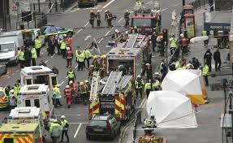
What is Triage?
Triage is the process of categorising patients based on the severity of their conditions and prioritising their care accordingly.
Triage is used in multiple casualty situations where the number of patients outweighs the resources on scene – whether this be a major incident or an RTC.
Notes:
Ref: Ambulance Care Essentials 2nd edition – Chapter 16 Trauma pg 247-248
Ambulance Care Essentials 2nd edition – Chapter 8 Scene Assessment pg 121-122

Slide 34
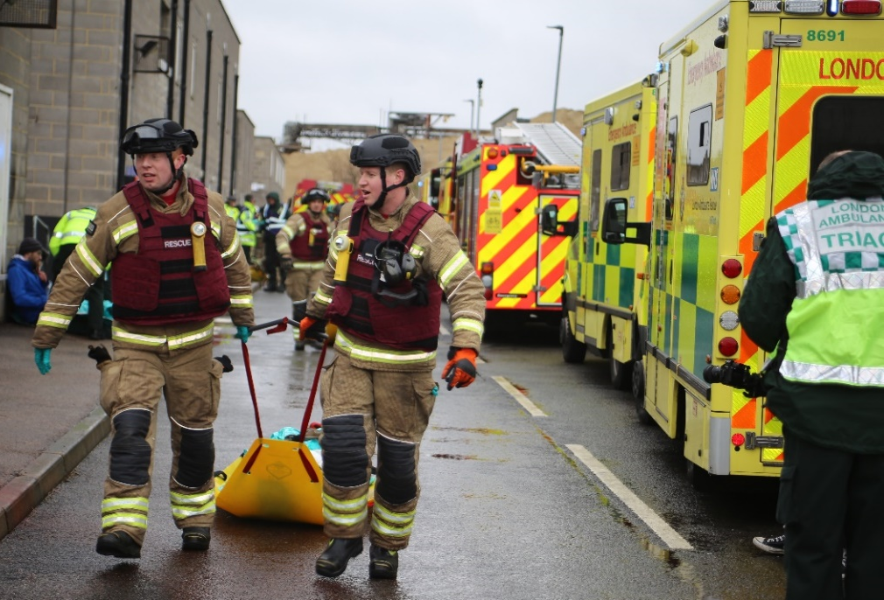
Multiple Casualty Incidents
First on scene actions
Updated to increase emphasis on promoting
casualty care at all stages.
1st Person - Co-Ordinate & promote casualty care
2nd Person - Scene survey & casualty care
3rd Person - Establish casualty clearing area
Subsequent responders should report to the first person or Ambulance Scene Commander.
Notes:
Picture – 2023 – Exercise Spring Resolve
Key Points:

Slide 35
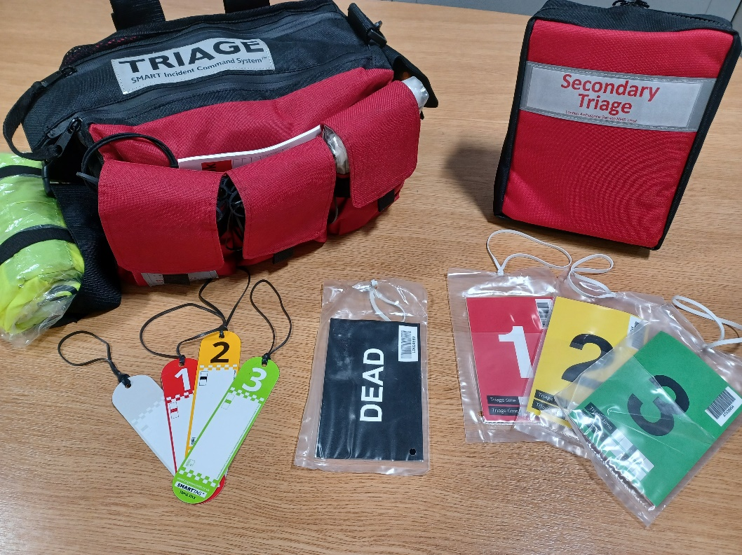
Multiple Casualty Incidents
Ten Second Triage
  All responders
  Emphasis on Live Saving Interventions
  Not Breathing Category
  Different Tags / Options for marking
Secondary Triage
  Clinical responders
  Different Triage Tags
  Updated decision making for implementation
Notes:
Picture – 2023 LAS Triage Packs
Key Points:
Life Saving Interventions and Ten Second Triage are the priority
Always start with Ten Second Triage
Packs on all frontline vehicles will be updated to Ten Second Triage
Secondary Triage packs will be available on CTM, IRO, APP, TRU, HART & Equipment Vehicles
Other Information:
For Hazardous Area Response Team and Special Operational Response Team staff Toxic Triage remains available for hazardous materials incidents where PPE is required
Once casualties are in a clean area they can be re assessed using Ten Second Triage or Major Incident Triage Tool

Slide 36
Life Saving Interventions
Notes:
Key Points:
Emphasise that Life Saving Interventions are paramount
We need you to champion Life Saving Interventions, any conversations you have with staff about Triage – rephrase as Life Saving Interventions & Triage

Slide 37
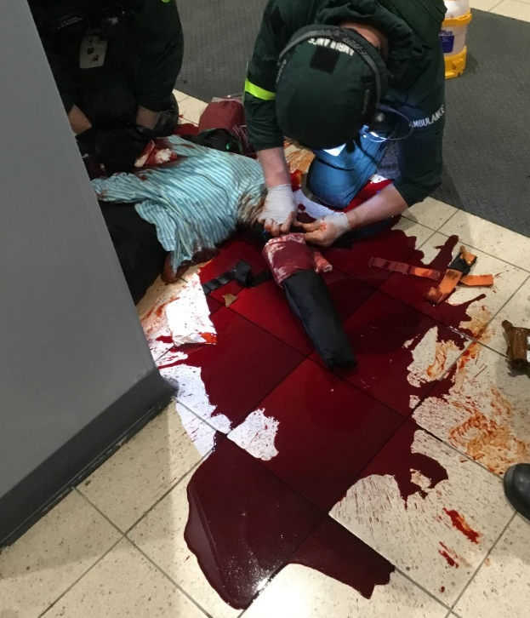
Life Saving Interventions
Control of external haemorrhage and airway management
Ten Second Triage incorporates two key Life Saving
Interventions:
Haemorrhage Control
Pressure
Tourniquet
Packing
If a junctional bleed injury is present it should still be packed and pressure applied for at least 3 minutes.
Where possible capable bystanders can be utilised in order to allow the responder to move on.
Notes:
Picture – Exercise Raptor, Heathrow
Key Points:
All severe bleeding should be aggressively managed

Slide 38
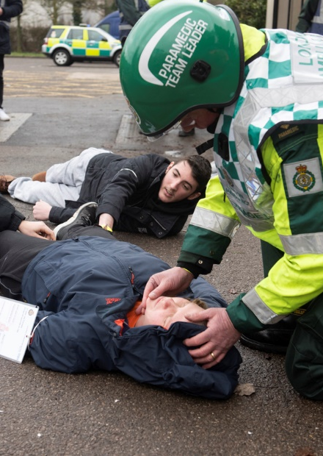
Life Saving Interventions
Control of external haemorrhage and airway maintenance
Ten Second Triage incorporates two key Life Saving
Interventions:
Airway Management
Positioning
Adjuncts
Notes:
Picture – Exercise Yellow Penguin. Chessington
Key Points:
Open the Airway and place in recovery position, use adjuncts when necessary

Slide 39
Ten Second Triage

Slide 40
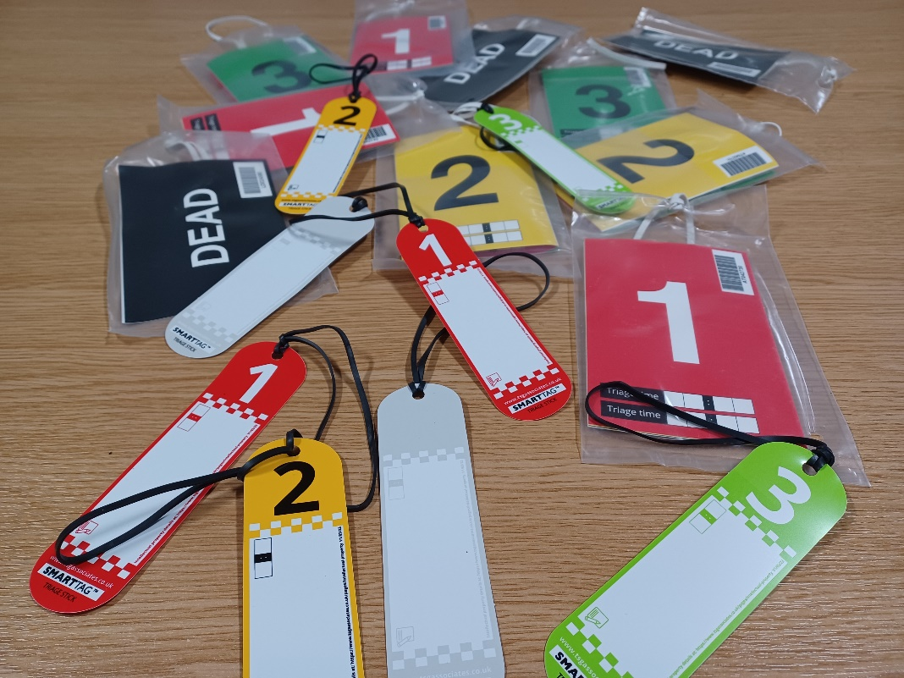
Multiple Casualty Incidents
Triage Priorities
Each Triage process uses a number of categories to help define the level and priority of care required.
Not Breathing – Only in Ten Second Triage Require urgent re assessment by a Clinical Responder
P1 – Immediate
P2 – Urgent
P3 – Delayed
Dead – Only by a Clinical Responder
Notes:
Picture - Selection of Triage Sticks and Triage Cards
Key Points:
P1 (Immediate) – Casualties who require immediate life saving procedures
P2 (Urgent) – Casualties who require surgical or medical intervention within 2 to 4 hours
P3 (Delayed) – Less serious casualties whose treatment can be safely delayed beyond 4 hours, might be able to received treatment on scene
Other information:
P1 Hold – (Still awaiting national sign off) Temporary decision not to treat a P1 casualty with low chance of survival at an acute
incident due to severity of injury or lack of resources to treat or transfer patient

Slide 41
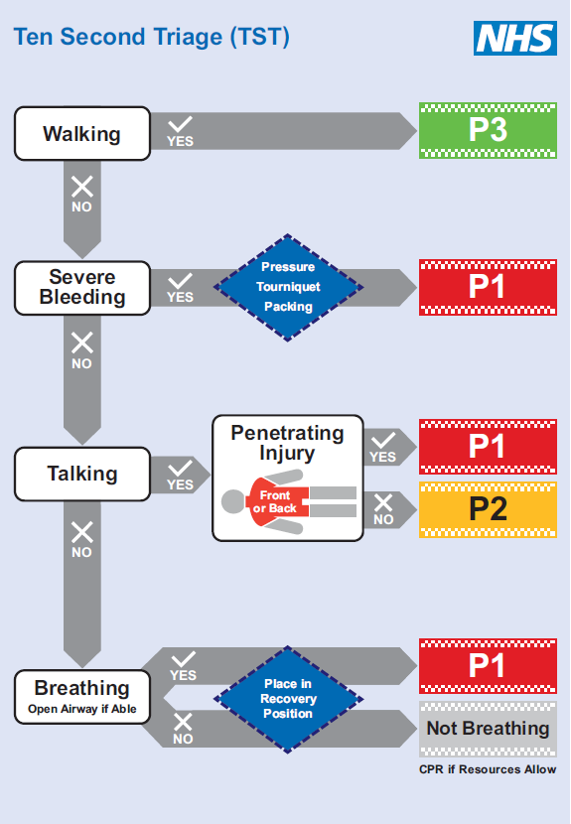
Ten Second Triage
Algorithm
Non-physiological triage focused on Life Threatening Injuries
Identify the most severely injured
Prioritise those who need immediate Life Saving Interventions
Optimise ability to move quickly and efficiently from one casualty to the next in order to save as many lives as possible
Supports CPR where resources allow
Notes:
Picture – Ten Second Triage Flow Chart
Key Points:
The simplicity of the tool minimises cognitive burden and frees up bandwidth to assist responders to treat casualties in what will be very challenging circumstances.
There are no physiological parameters; breathing and pulse rate are not measured allowing the tool to be used by those responders with little or no clinical training.
In addition, the tool does not triage casualties to dead but labels as not breathing, allowing for appropriate interventions, such as recovery position or CPR, depending on the circumstances until formal triage by a clinician.
Other Information:
Ten Second Triage moves away from relying on physiological measurements such as pulse and breathing rates allowing for a
More practical and achievable approach by reducing cognitive burden and increasing bandwith.
The TST is designed to be quick, simple and effective at prioritising large numbers of casualties rapidly with a focus on immediately providing lifesaving interventions (LSI). These LSI include control of severe bleeding and opening of the airway, which are known to be the key requirements to maximise patient survival in the early stages of injury.

Slide 42
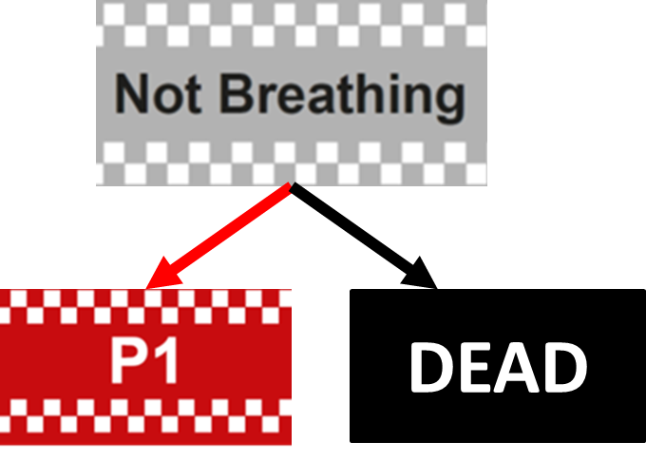
Clinical Assessment
Re assessment
Ten Second Triage will be followed by reassessment of casualties marked as ‘not breathing’ by healthcare professionals as soon as possible.
If considered amenable to ongoing resuscitation re tag as P1 and prioritise treatment and evacuation.
Where a full assessment shows that ongoing resuscitation will be futile or the resources required to allow any chance of successful resuscitation are not available then they will be recognised as dead at this point with an appropriately completed Black Dead tag applied.
Notes:
Picture – Not Breathing re assessment options
Key Points:
Re assessment ideally by a Paramedic (minimum TEMT) and in line with LAS Verification Of Fact Of Death procedures
A clinician with appropriate time re assesses a casualty with silver not breathing tag and considers them a viable resuscitation or Dead
“if considered amenable to resuscitation” is the exact wording taken from the NARU published guidance

Slide 43
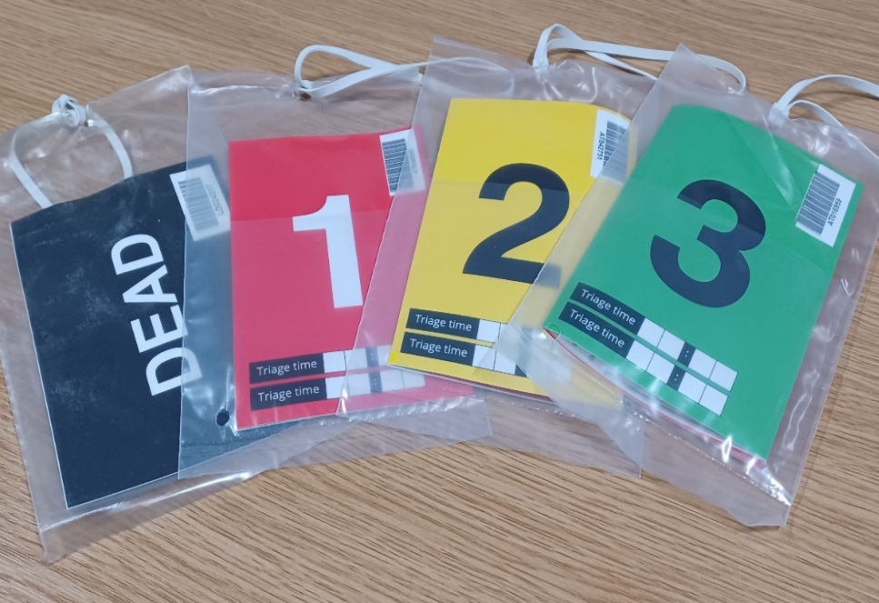
Secondary Triage
Decision Making
Once Life Saving Interventions and Ten Second Triage have been completed, the LAS Scene Commander will decide on whether to:
Continue with Ten Second Triage.
Return to Business As Usual standard clinical practice.
Commence Secondary Triage with either:
On scene senior clinician led Triage.
Or
Use Major Incident Triage Tool.
Notes:
Picture: LAS Secondary Triage Tags
Key Points:
Decision made by LAS Scene Commander, should only be taken once Ten Second Triage is complete for all casualties that can be accessed.
Secondary Triage likely to be instituted once casualties reach a Casualty Collection Point or Casualty Clearing Station rather than being performed on scene

Slide 44
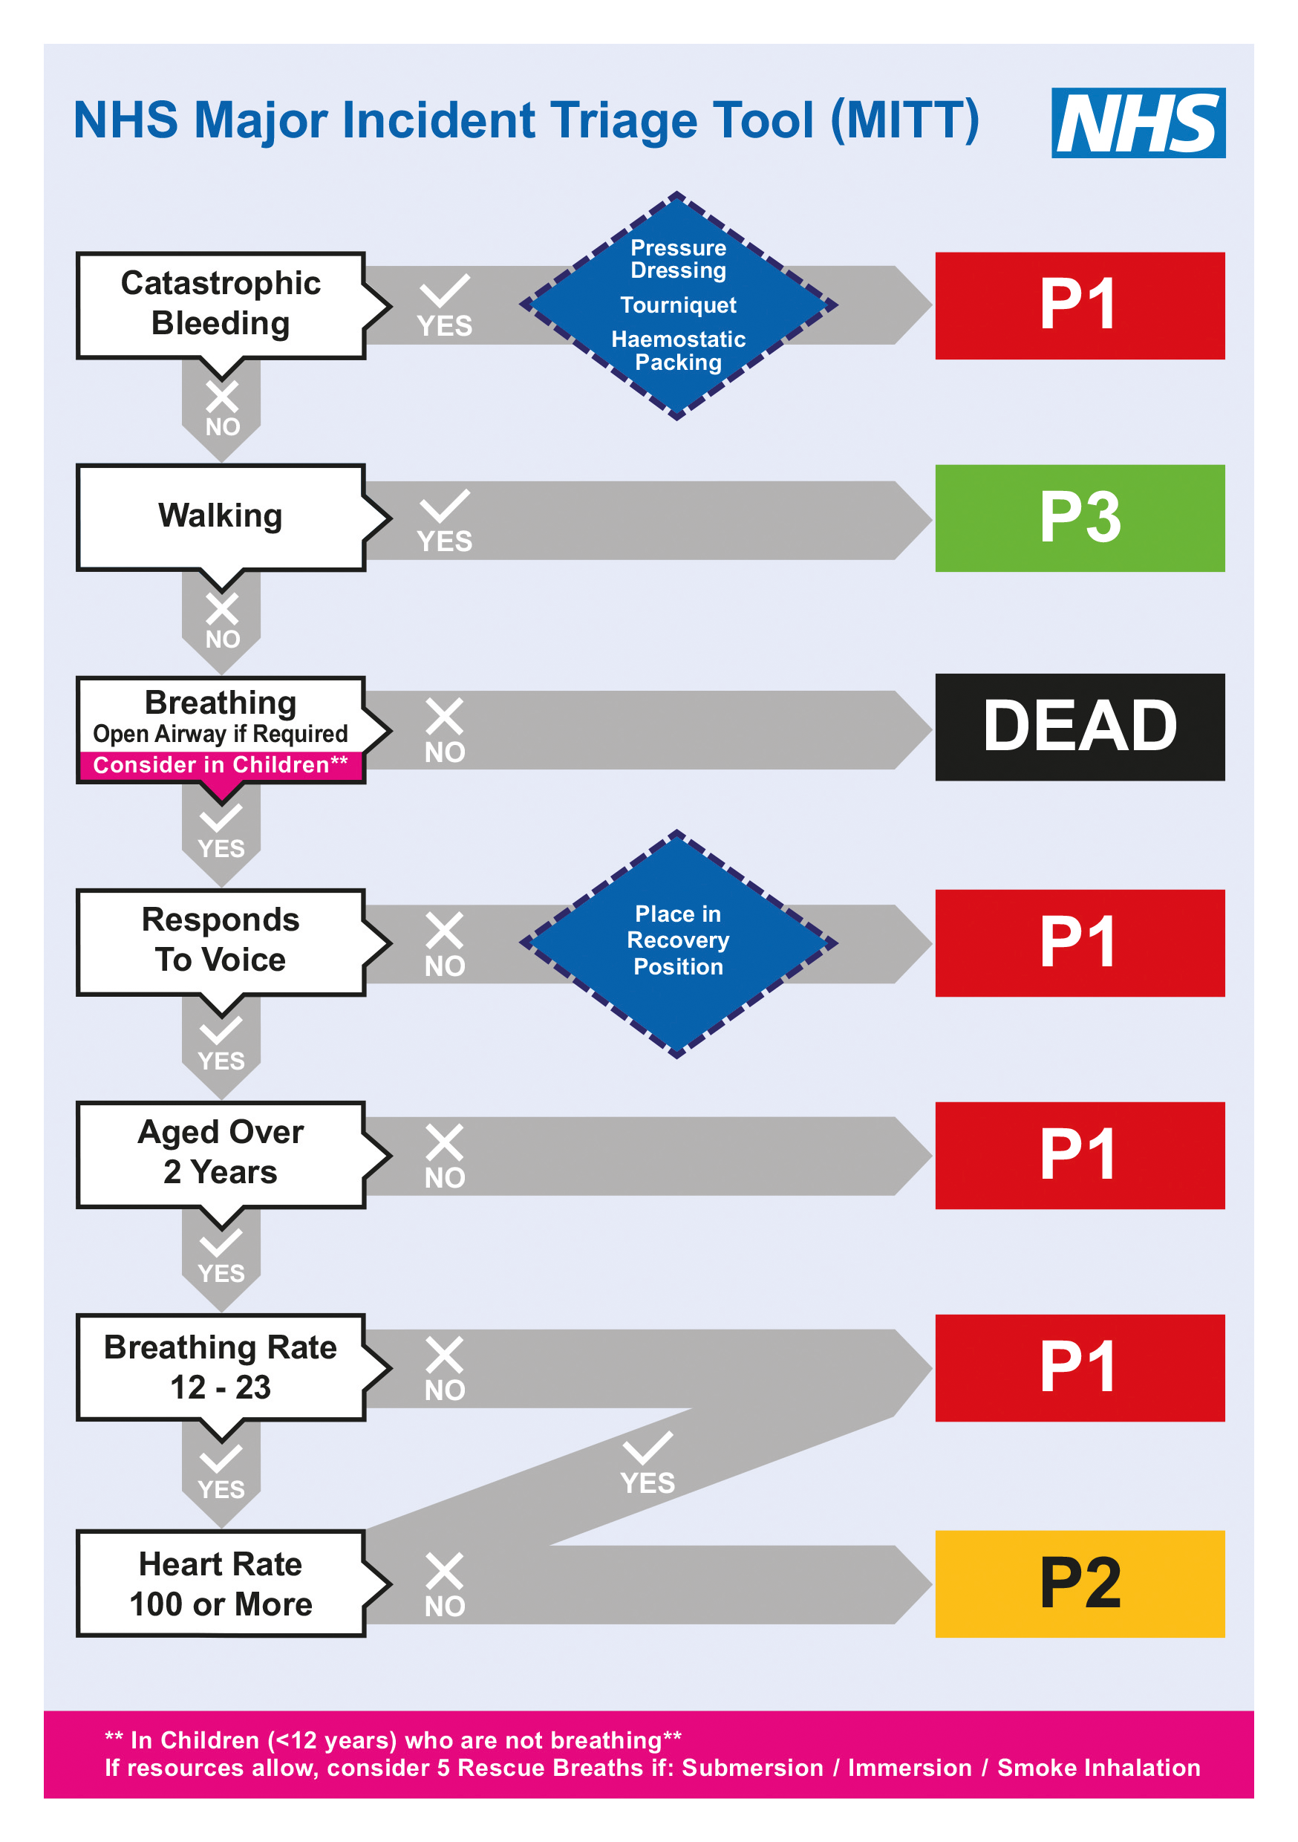
Secondary Triage
Major Incident Triage Tool
Secondary to Life Saving Interventions and Ten Second Triage.
Undertaken by Clinical Responders only.
Record with full size Secondary Triage Tags.
For use at Casualty Collection Points or Clearing Stations rather than being performed in situ.
Notes:
Picture – Major Incident Triage Tool Flow Chart
Key Points:
Used in Secondary Triage
Clinical Responders – Health Care Professional or responder on behalf of an NHS Ambulance Trust
Any child under 2 is automatically categorised as a P1 owing to increased mortality and morbidity following injury in this chohort.
Additionally accurate assessment of this age group in notoriously difficult especially for those with limited paediatric experience
For Children under 12 who are not breathing, rescue breaths should be administered if resources allow.
This is in the context of a mechanism of injury associated with hypoxia, such as submersion, immersion or smoke inhalation.

Slide 45
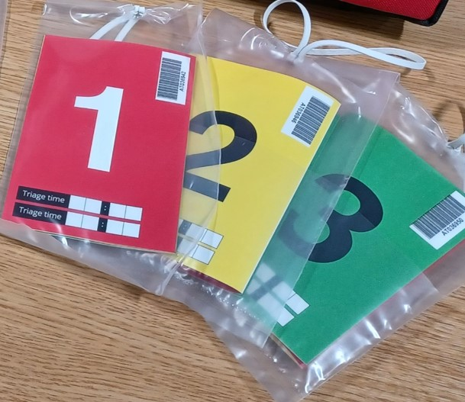
Secondary Triage
Triage Tags
A multifold card with P1, P2, and P3 panels.
Fold the card so that the required priority is
showing.
Also has space to record casualty information
observations and interventions.
The separate Dead Tag is used in both Ten Second Triage and Secondary Triage.
Notes:
Picture – LAS Secondary Triage Tags
Key Points:
Secondary Triage Tags are NOT carried on Ambulances or Response cars
They will be available on CTM, IRO, APP, TRU, HART and Equipment Vehicles

Slide 46
Over and under-triaging
Over-triage is dangerous as it puts pressure on the limited resources on scene and has been linked to critical mortality.
Under-triage is dangerous as the patient will not receive medical attention when it is required.
Notes:
Ref: Ambulance Care Essentials 2nd edition – Chapter 8 Scene Assessment pg 121-122
E-learning – smart D net in afternoon

Slide 47
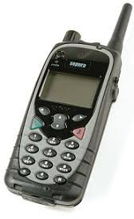
Reporting mechanisms
SCENE:
Used when assessing the initial trauma scene to enable effective management
S – Safety
C – Cause (MOI)
E – Environment
N – Number of patients
E – Extra resources needed
METHANE:
Provides initial communication and details at a major incident
M – Major incident declared
E – Exact location
T – Type of incident
H – Hazards known or potential
A – Access and egress for vehicles
N – Number of casualties
E – Emergency services required
Notes:
Ref: Ambulance Care Essentials 2nd edition – Chapter 8 Scene Assessment pg 116
Joint Royal collages Ambulance liaison committee (JRCAL Plus) trauma Emergency in Adults- Overview. Accessed 11th May 2020.
METHANE is used for major incident reporting – this will be covered more in depth through the Smart D-Net training and by EPRR a different day. It is important the students know the basics of this.
CHALETS is no longer used.

Slide 48
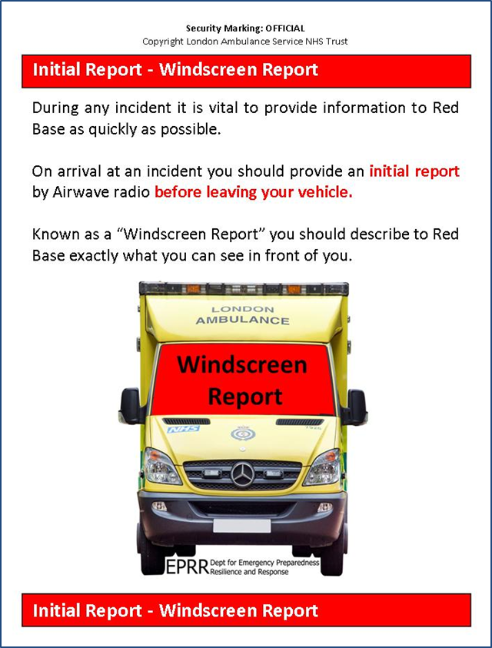
This should be on all sun visors in ambulances
What is Triage?
Windscreen report:
Press Priority on airway radio
Give EOC your call sign and CAD number
Tell them exactly what you can see
Follow with a METHANE report
Notes:
Ref: Ambulance Care Essentials 2nd edition – Chapter 8 Scene Assessment pg 116

Slide 49
Handover models
ATMIST:
Used for handover in trauma
A – Age
T – Time of incident
M – Mechanism
I – Injuries
S – Signs and Symptoms
T – Treatment given/immediate needs
CATMIST:
Used for trauma blue call
C - Call sign/CAD
A – Age
T – Time of incident
M – Mechanism
I – Injuries found
S – Vital signs
T – Treatment given
Notes:
Ref: Ambulance Care Essentials 2nd edition – Chapter 3 Communication pg 20
Major Trauma Tree – has CATMIST printed on one side

Slide 50
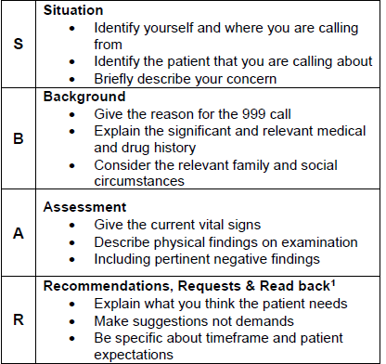
What is Triage?
A format used for handover extensively within the NHS is SBAR.
SBAR allows for a logical sequence of concise information to be handed over
Can be used in many situations. E.g. hospital handover, on scene handover to arriving crews etc.
S
B
A
R
Notes:
Ref: Ambulance Care Essentials 2nd edition – Chapter 3 Communication pg 20
There is good evidence that using a structure or format improves the transfer of information between clinicians. There are many different forms, but one that is used extensively in the NHS is ‘SBAR’. Originally devised as a brief reporting mechanism in the US Navy, it allows clear and concise communication, and affords opportunities to check that the information has been received accurately.
May be worth writing information down in the format of SBAR to allow a smooth and informative handover.
PRINT THIS SLIDE AS FULL SIZE FOR STUDENTS

Slide 51
The importance of reporting mechanisms
Reporting mechanisms
Reporting mechanisms such as revised trauma system, SBAR, (C)ATMIST and METHANE allow for clear, concise, appropriate information to be passed to the relevant person. Whether this is someone in control via radio, colleagues or staff in a trauma centre.
Reporting mechanisms explain how quickly the patient will require observations and interventions
Notes:
Ref: Ambulance Care Essentials 2nd edition – Chapter 3 Communication pg 20

Slide 52
The importance of an effective and structured handover
Handover
A handover occurs when you are transferring the care of your patient (therefore passing information about them) to another healthcare professional.
If important information is missed then it can lead to errors in treatment and cause harm to the patient.
The risk of errors increases in high stress situations – when an accurate handover is most important.
Notes:
Ref: Ambulance Care Essentials 2nd edition – Chapter 3 Communication pg 20

Slide 53
Tips
Ensure you are talking to the person responsible for your patient’s care.
Make notes in advance to ensure you do not miss vital information.
Ensure everyone is listening before you start handing over.
Ensure your handover is clear and concise.
Write all the information on your PRF to be provided to the hospital when it is complete.
Notes:
Ref: Ambulance Care Essentials 2nd edition – Chapter 3 Communication pg 20

Slide 54

Questions?

